Slide 1

AUTOMOBILE DATASET ANALYSIS AND PRICE PREDICTION
By: Sunday, Festus, Gregory, and
Michael

Slide 2
We planned to divide it into four parts
1. Data Wrangling
-pre-processing data in python -dealing missing values -data formatting -
2. Exploratory Data Analysis –
Boxplot -correlation stats
3. Model Evaluation:
Regression Plots
4. Model Development:
Simple Linear Regression
Multiple Linear Regression

Slide 3

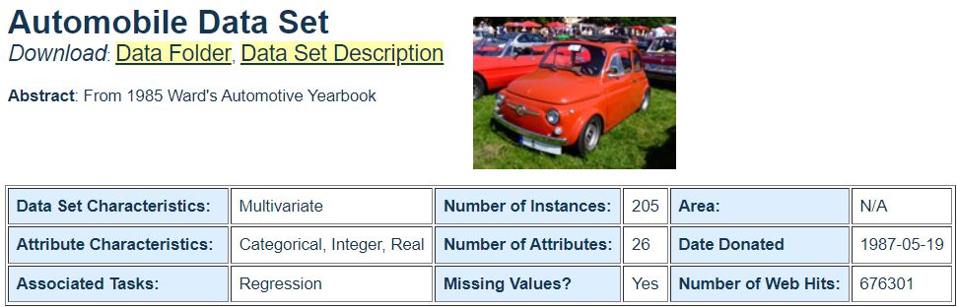
Data Source

Slide 4
1. Data Wrangling
Softwares and Libraries Used:
- Jupyter Notebook - Numpy - Pandas - Matplotlib – Seaborn -sklearn

Slide 5
Identify missing values
Convert "?" to NaN
In the car dataset, missing data comes with the question mark "?". We replace "?" with NaN (Not a Number), which is Python's default missing value marker for reasons of convenience.
Solution
df.replace("?", np.nan, inplace = True)

Slide 6
Dealing with missing data
Each column has 205 rows of data and 7 columns containing missing data:
"normalized-losses": 41 missing data
"num-of-doors": 2 missing data
"bore": 4 missing data
"stroke" : 4 missing data
"horsepower": 2 missing data
"peak-rpm": 2 missing data
"price": 4 missing data
Replaced by mean

Slide 7
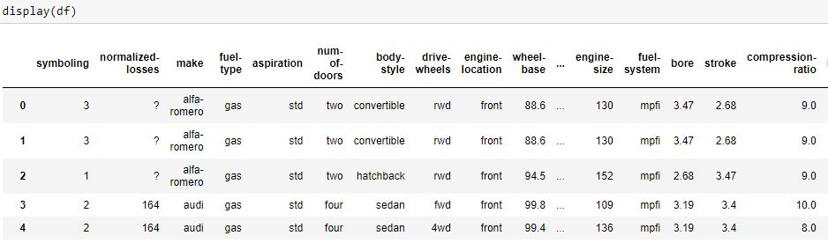
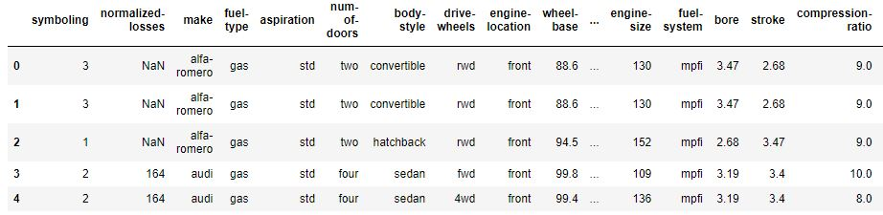
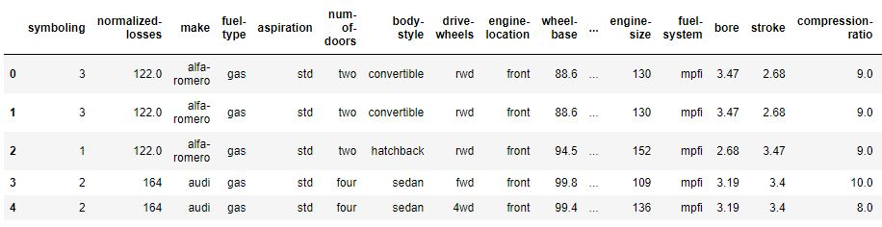
Dataset
Missing value filled using the mean

Slide 8
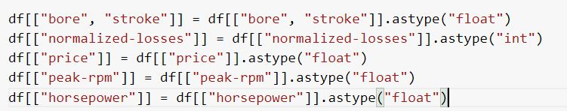
Data type conversion
Some columns have the wrong data type. Numerical variables should be float or int, and string variables like categories should be object.
For example, the variables 'bore'and’stroke' should be of type 'float' or 'int', but they are of type 'object'. Using the "astype()" technique, we must format each column's data type

Slide 9
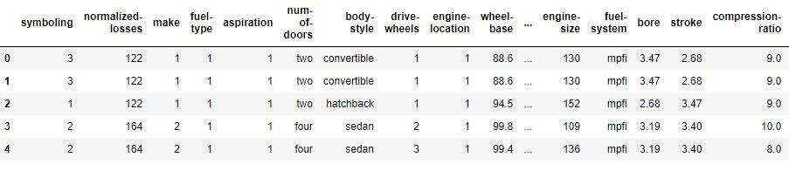
Feature mapping
To find the correlation between price and other variables with object type, we decided to map.
This was also useful in improving the performance of machine learning algorithms

Slide 10
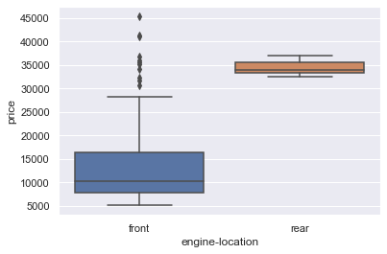
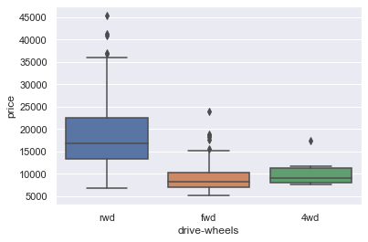
2.Data Exploration Boxplots representing effect of engine location and wheel drive with prices.

Slide 11
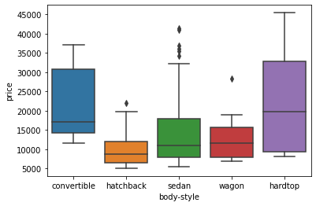
Price and body-style relation

Slide 12
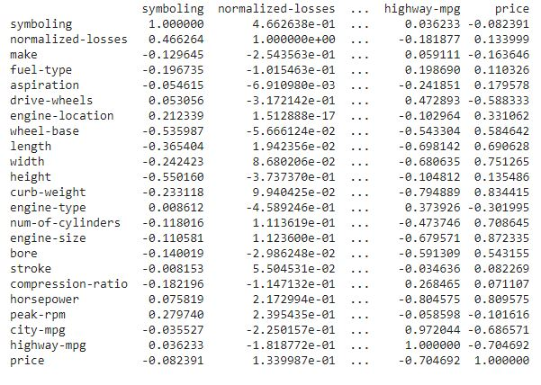
Correlation between price and other attributes

Slide 13
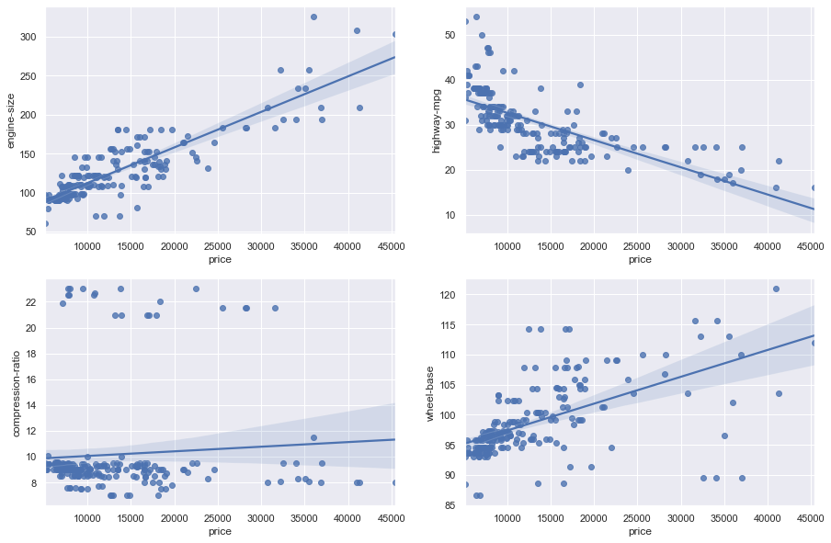
3. Model Evaluation: Regression Plots engine size, highway-mpg, compression-ratio and wheel-base with price

Slide 14
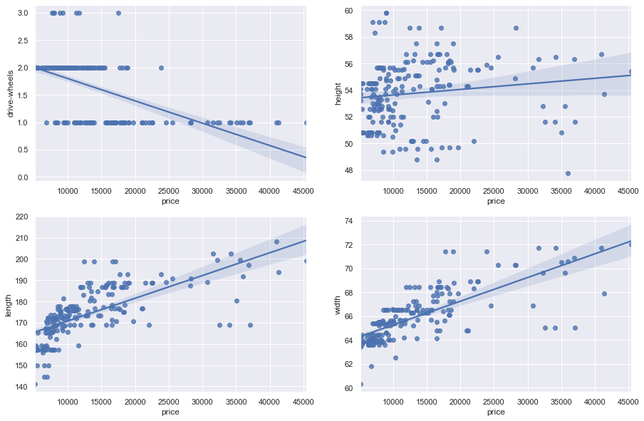
Drive wheels, height, length, and width with price

Slide 15
Simple and multiple linear regression
Simple Linear Regression is a method to help us understand the relationship between two variables:
The predictor/independent variable (X)
The response/dependent variable (that we want to predict)(Y) – price
Multiple Linear Regression
This method is used to explain the relationship between one continuous response (dependent) variable and two or more predictor (independent) variables.

Slide 16
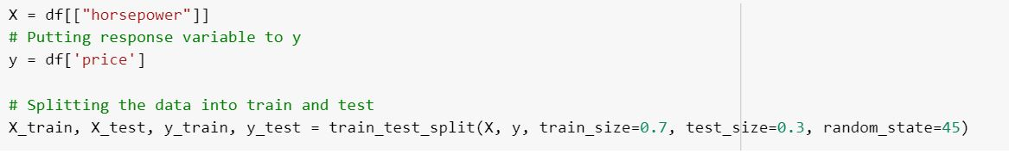
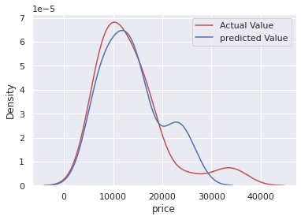
Model building: simple linear regression
Before building the model, we’ll split the data into train and test data, similar to the linear regression model.
So that we’ll make the model using train data and evaluate the model on test data.
Model score:0.48983027641076

Slide 17
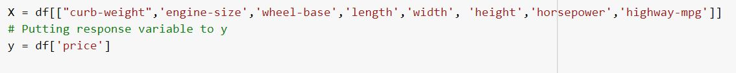
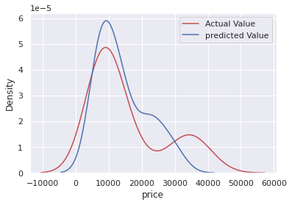
Multiple linear regression
We added more parameter that showed a strong correlation to the price of the vehicle which include the curb-weight,engine-size,'wheel, base,length,width,height,horsepower,highway-mpg
Score improved to:0.7558481022290

Slide 18
Conclusion
When we compare these two models, we find that the Multiple Linear Regression model is the better at predicting price from our dataset.
This finding makes sense given that we have 26 factors in total and know that more than one of them is a possible predictor of the final automobile price.
curb-weight, engine-size, wheel-base, length, width, height, horsepower, highway-mpg

Slide 19
Thank you!

